Slide 1
Smart Automobiles Manufacturing
-Team GigaByte

Slide 2
Overview
An IoT application for smart production of automobiles.
By using unique RFID tags to track each product and by using machines equipped with sensors capable of sensing production data, the project aims to implement the following ideas:
Component replenishment
Smart customization
Product memory
Factory Safety Alerts

Slide 3
Smart Customization
The production line should be capable of producing an item with a batch size of one. Each product is customized by the system based on the specification requested by the customer.
The RFID tag of the product will have the information about the desired specifications.
The production modules read this information and manufacture the product based on the specifications.

Slide 4
Component replenishment
The available supplies of all the components used in the production are tracked in real time using sensors installed in the warehouse.
Whenever a component goes below a threshold level, a replenishment request is raised automatically by the system. This avoids the shutdown of the whole production line which may occur due to the unavailability of one item.
The system stores the quantity of each component used for every module. This helps in resource management and analyzing the component use.

Slide 5
Product Memory
The production information for each product is stored in the system. The production information contains data about the actions performed on the product by the different modules in the production line.
The production data contains information like the exact temperature of the room when the product was manufactured, the amount of torque used to tighten a certain screw, thickness of paint used etc. These data will help identify or fix any defects that might arise later.
The system will have the IDs of the products to be recalled when the cause of the defect is identified.

Slide 6
Factory Safety Alerts
The alert sensors in the factory, will keep track of the temperature and humidity values at a specific instance of time.
This will maintain employee safety and production environment safety.
Factory alerts to highlight the temperature and humidity values below a threshold level.

Slide 7
Production Line Flow
Chassis Module
Involves forming of physical frame or structure of an automobile
Engine Module
Body Module
Involves assembling of parts by using various joining techniques.
Transmission Module
Paint Module
Dipping into zinc tank
Applying layer of paints and fillers.
Applying finishing coats.
Assembles Engine specified in customization on Chassis Frame
Assembles chosen transmission type into the model

Slide 8
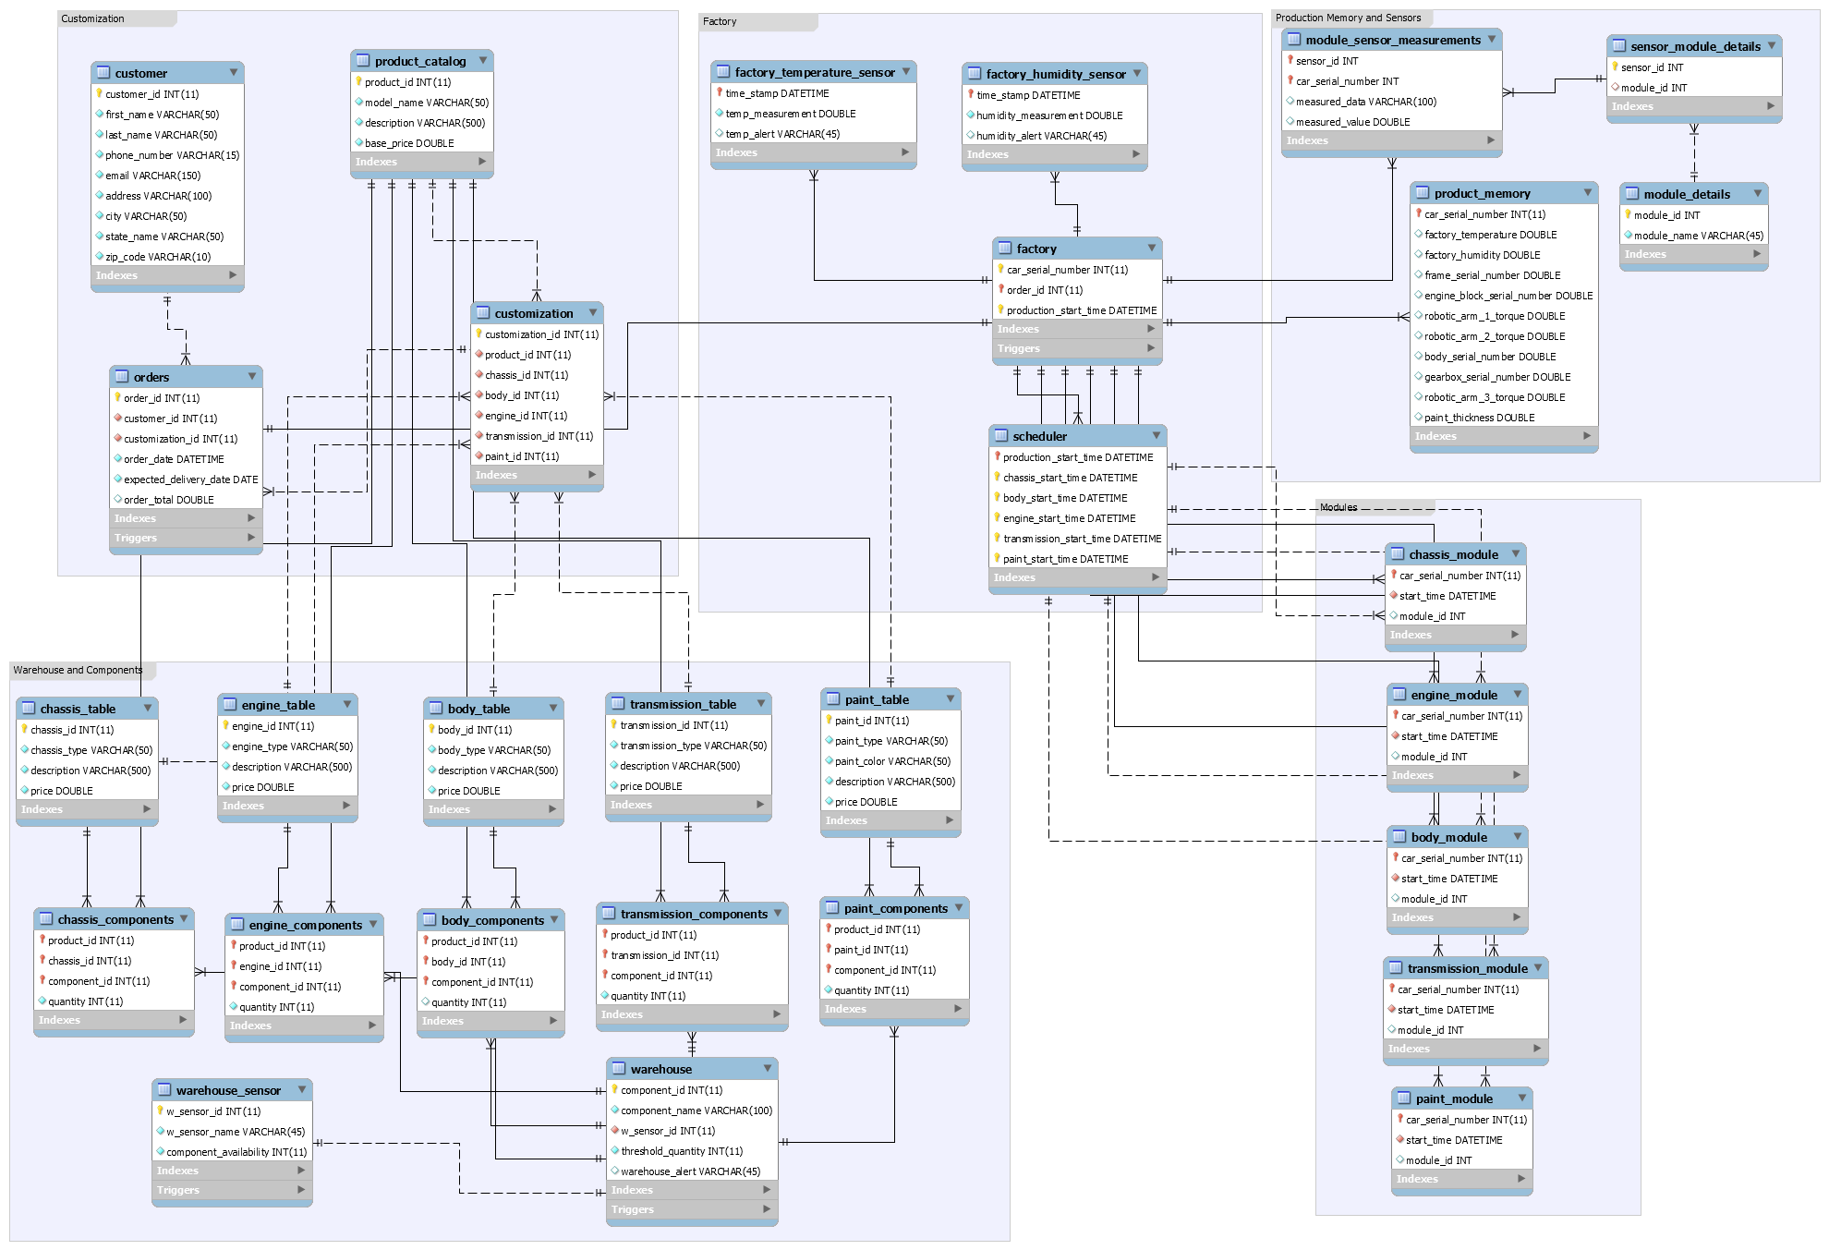
EER Diagram

Slide 9
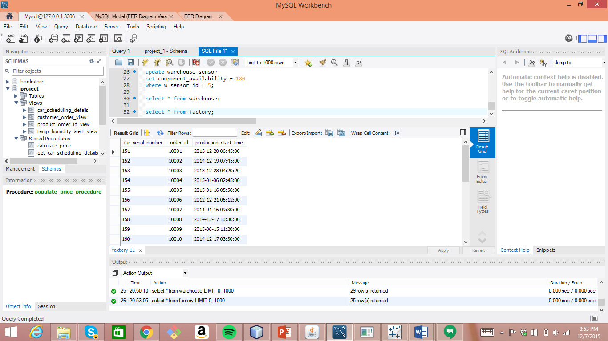
Salient Features
Automatic creation of car serial number and production start time for every new order placed.
Implementation: Trigger
Response:

Slide 10
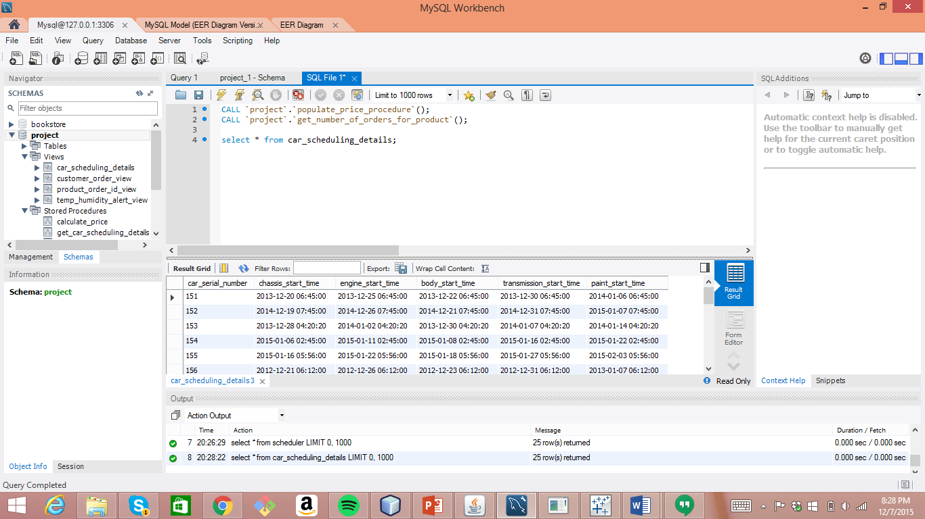
Automatic scheduling of the production modules for every automobile.
Implementation: Trigger
Response:

Slide 11
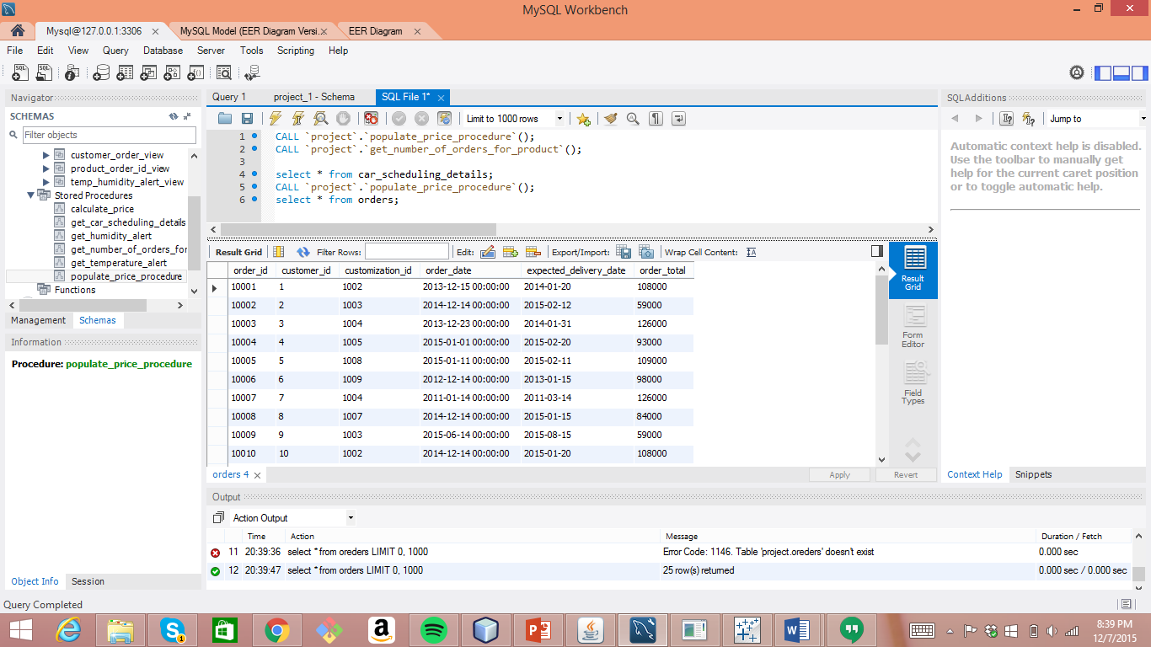
Calculation of the estimated price for every car on the basis of the customization chosen by the customer and the components user for every production module.
Implementation: Stored Procedure
Response:

Slide 12
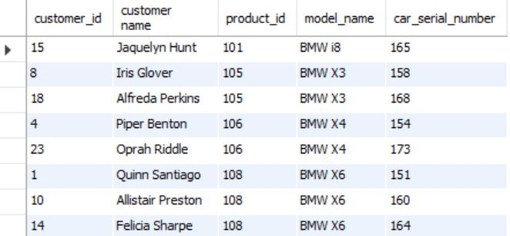
View the car models ordered by every customer
Implementation: View
Response:

Slide 13
Users playing specified roles:
System Admin
Factory Admin
Warehouse Admin
Customer
Implementation: User Privileges

Slide 14
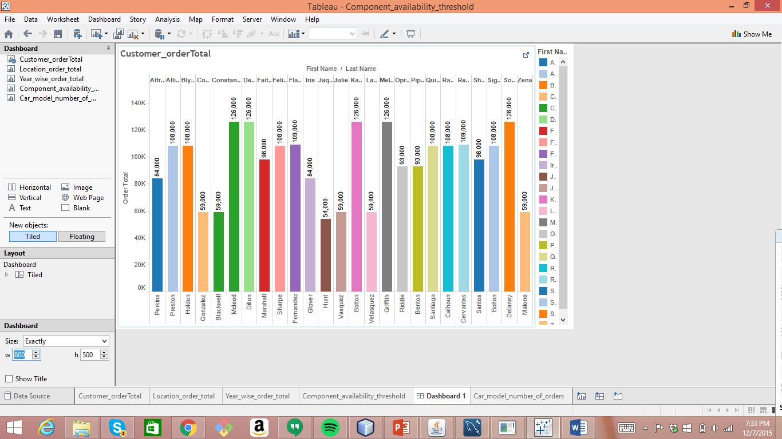
Analytics Customer order details

Slide 15
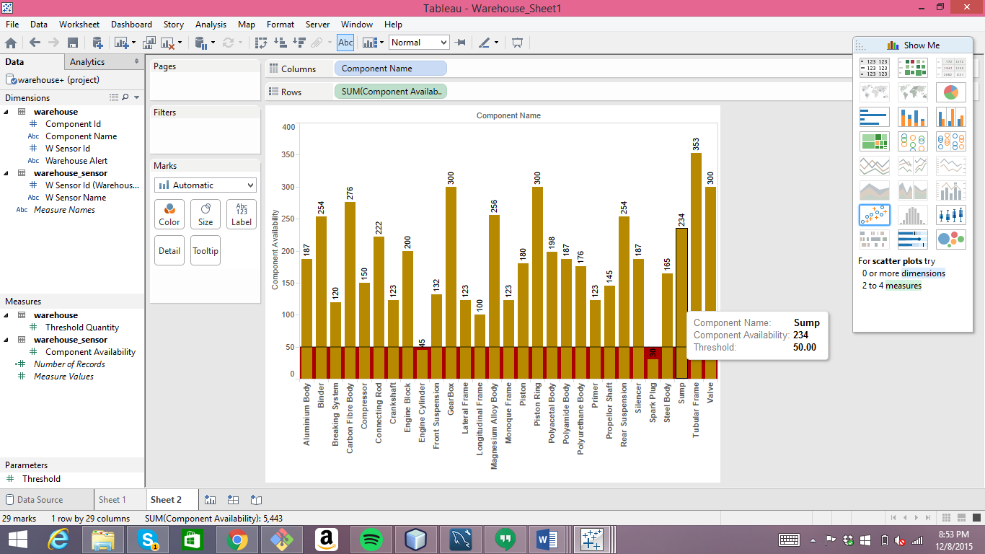
Component Availability

Slide 16
Thank You !

